Slide 1


Electroencephalographic Fractal Dimension in Healthy Ageing and Alzheimer’s Disease
Authors:
1. Fenne Margreeth Smits^{A,B} 2. Camillo Porcaro^{A,C,F}
3. Carlo Cottone^{A}
4. Andrea Cancelli^{A,D}
5. Paolo Maria Rossini^{D,E}
6. Franca Tecchio^{A,E}
LET’S—ISTC—CNR, Ospedale Fatebenefratelli, Isola Tiberina, Rome, Italy
University of Amsterdam, Amsterdam, The Netherlands,
Institute of Neuroscience, Newcastle University, Medical School, Newcastle upon Tyne, United Kingdom,
Institute of Neurology, Cattolica del Sacro Cuore University, Rome, Italy,
Unit of Neuroimaging, IRCCS San Raffaele Pisana, Rome, Italy,
Department of Information Engineering, Università Politecnica delle Marche, Ancona, Italy
Journal Name: PLOS One Publication Year: 2016
Presented By:
Md. Ferdous
Roll: 2007512
Bio-inspired Computing Techniques project
Presentation Date: 21.06.2021

Slide 2
Presentation Outline
Introduction
Objective
Background Studies
Materials and Methods
Experimental Results
Conclusions
2
Notes:
A small group of individuals met in New York and founded the AIEE to advance the new field and represent the US at the 1884 International Electrical Exhibition in Philadelphia.

Slide 3

Introduction
Alzheimer’s Disease (AD) patients display a ‘slowing’ of brain activity.
Neural activity shows similar features over and over again on a scale-free basis.
Loss of complexity in brain activity means that the neural system of the brain is less flexible and less efficient in processing.
3

Slide 4
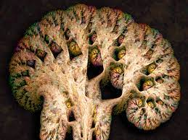

Objective
Tomoyuki Higuchi
Investigate whether the fractal dimension is sensitive to decreases in neural efficiency typical of healthy and/or pathological brain aging.
Estimated Higuchi’s fractal dimension (HFD) of EEG-derived brain activity.
HFD discriminated in about 67% of cases while all other indices were below 63%.
4

Slide 5
Background Studies
Alzheimer’s disease are the most common disorders in the elderly population.
Measuring complexity of brain activity using EED signal/data would be indicator of (early) AD diagnosis.
Fractal analysis using Higuchi’s fractal dimension (HFD) of EEG-derived brain activity.
5

Slide 6
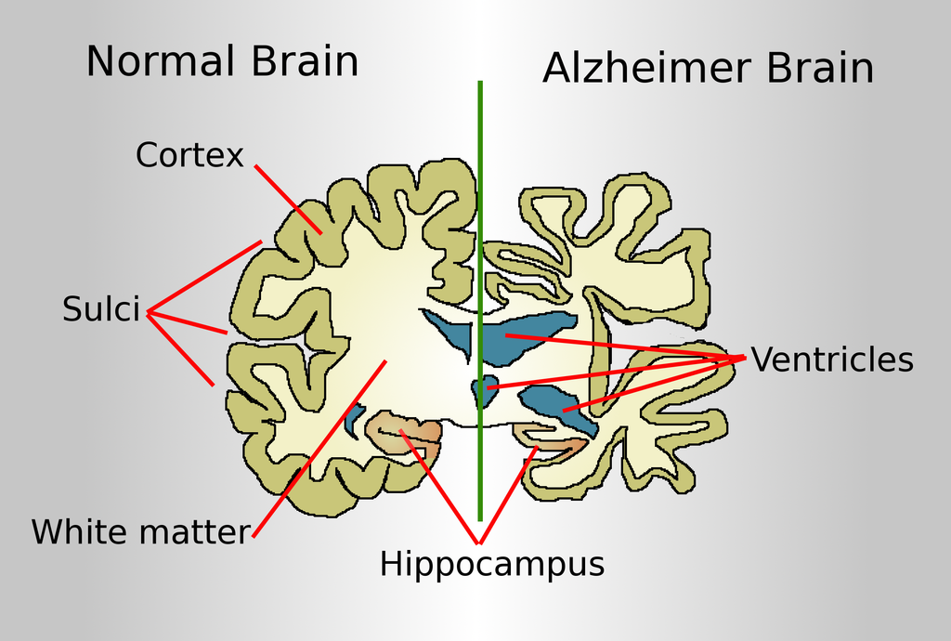
Alzheimer Disease
Alzheimer's disease is an irreversible, progressive brain disorder.
Neurons are injured and die throughout the brain. Connections between networks of neurons may break down.
Many brain regions begin to shrink. Significant loss of brain volume.
6

Slide 7
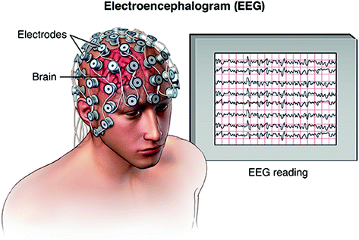
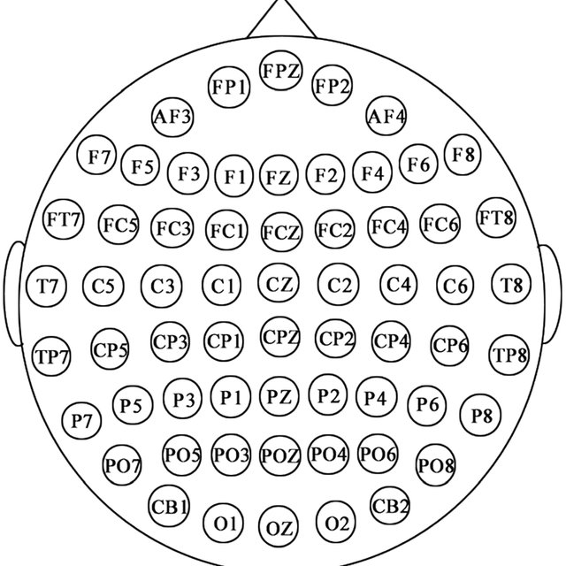
EEG Data
EEG data collection
Channel/Electrode representation
7

Slide 8
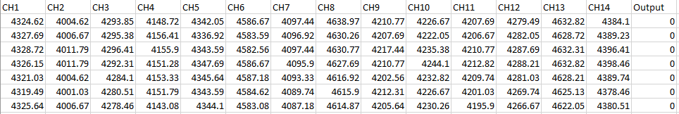
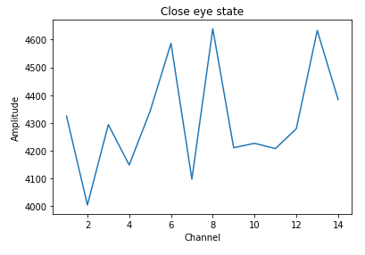
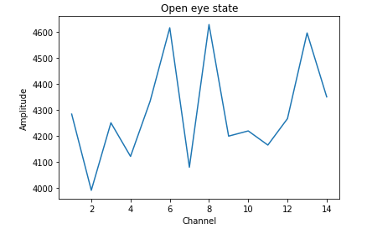
EEG Data (Cont…)
EEG Eye State Data Set from UCI machine learning repository
8

Slide 9
Fractal
Fractal is a never-ending pattern.
Complex patterns that are self-similar across different scales.
Nature is full of fractals e.g. trees, rivers, coastlines, mountains, clouds, seashells, hurricanes etc.
Neural activity shows similar features over and over again on a scale-free basis and can be quantified by the fractal dimension
9

Slide 10
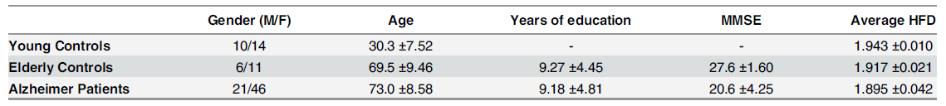
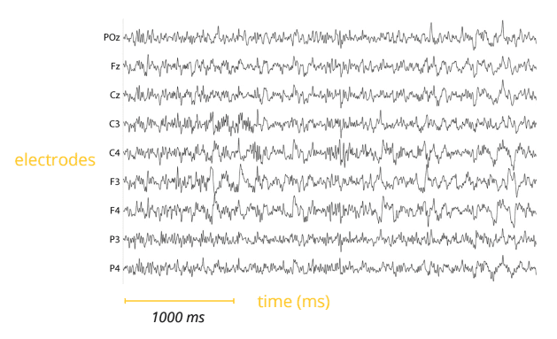
Materials and Methods
Estimated Higuchi’s fractal dimension directly from the EEG time series data.
10

Slide 11
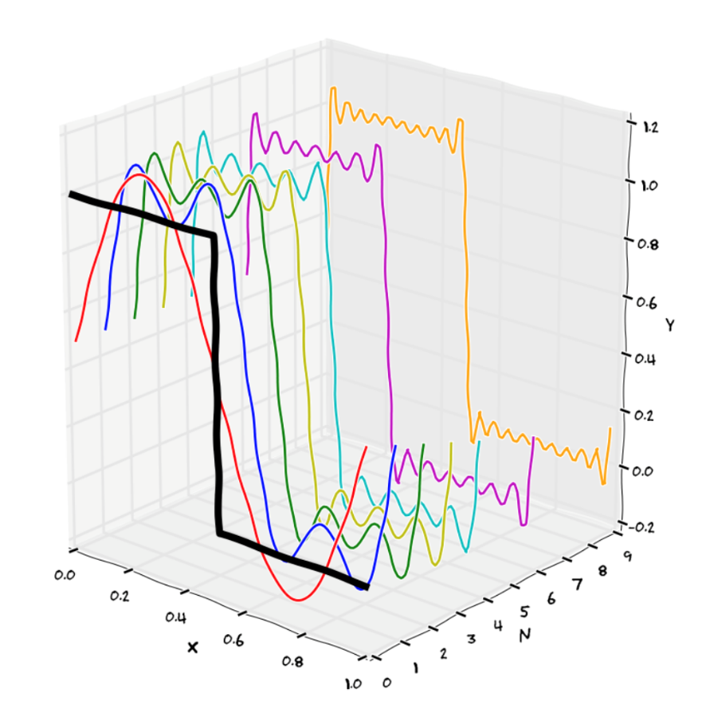
Materials and Methods (Cont…)
Why Higuchi’s fractal dimension?
Mathematical tools that go beyond the classic Fourier analysis.
FFT works upon the hypothesis of stationary signals.
Resting state exhibits dynamics i.e. multiple activated-deactivated states resulting in a non-stationary regime.
11

Slide 12
Materials and Methods (Cont…)
Why Higuchi’s fractal dimension?
Fluctuation frequencies display the ‘power law’ dependence.
Signal fractal dimension corresponds to the exponent of this exponential function.
HFD was the single best performer comparing between healthy elderly and those affected by AD
12

Slide 13
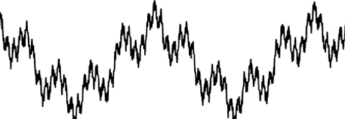
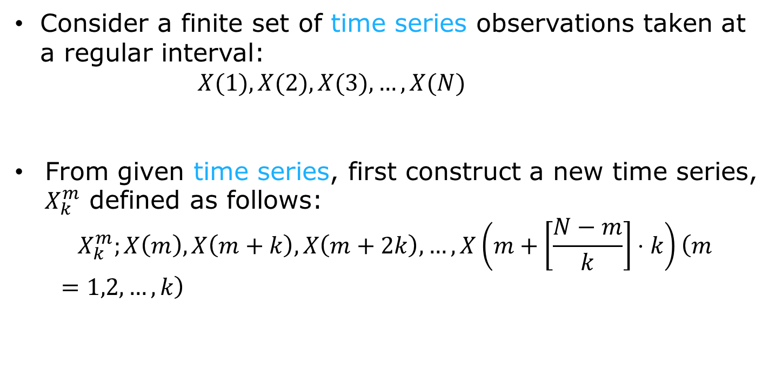
Materials and Methods (Cont…)
Higuchi’s Fractal Dimension
Consider a finite set of time series observations taken at a regular interval:
$X(1),X(2),X(3),…,X(N)$
From given time series, first construct a new time series, $X_{k}^{m}$ defined as follows:
$${ X}_{k}^{m};X\left(m\right),X\left(m+k\right),X\left(m+2k\right),…,X\left(m+\left[\frac{N−m}{k}\right]⋅k\right)\left(m=1,2,…,k\right)$$
EEG signal
Fractal EEG signal
13

Slide 14
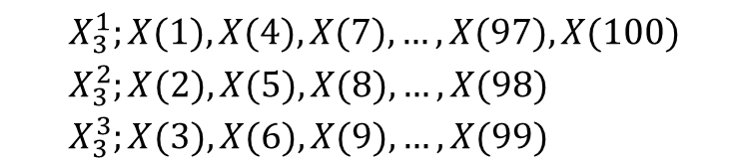
Materials and Methods (Cont…)
Higuchi’s Fractal Dimension
$${ X}_{k}^{m};X\left(m\right),X\left(m+k\right),X\left(m+2k\right),…,X\left(m+\left[\frac{N−m}{k}\right]⋅k\right)\left(m=1,2,…,k\right)$$
[ ] denotes the Gauss' notation and both k and m are integers.
m and k indicate the initial time and the interval time, respectively.
For a time interval equal to k, we get k sets of new time series.
In the case of k = 3 and N = 100, three time series obtained by the above process are described as follows:
$$\begin{aligned}&X_{3}^{1};X(1),X(4),X(7),…,X(97),X(100) \\ &X_{3}^{2};X(2),X(5),X(8),…,X(98) \\ &X_{3}^{3};X(3),X(6),X(9),…,X(99)\end{aligned}$$
14

Slide 15
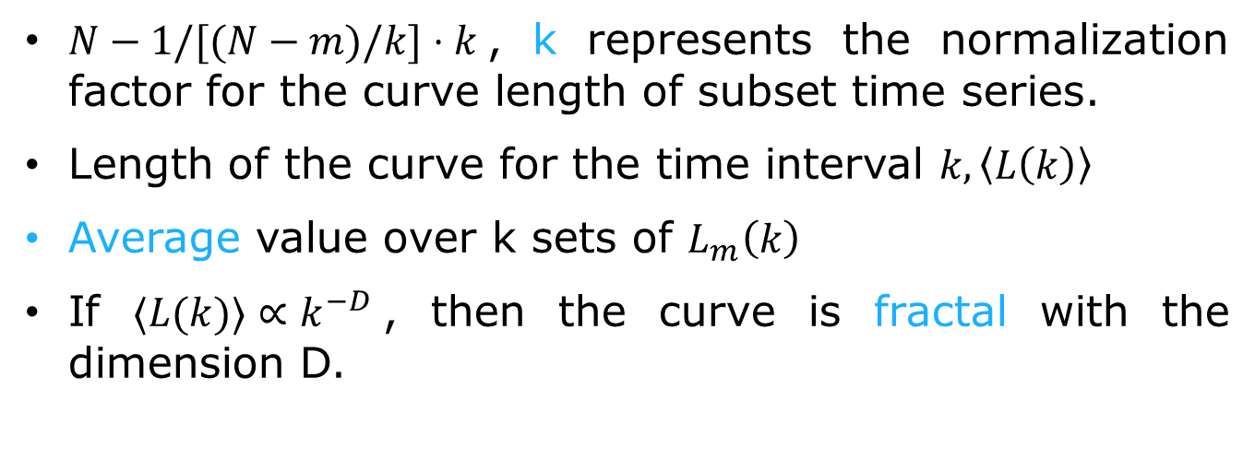
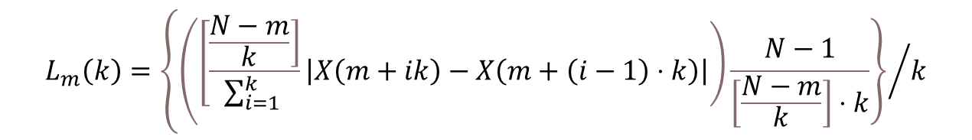
Materials and Methods (Cont…)
Higuchi’s Fractal Dimension
Length of the curve, $X_{k}^{m}$ , as follows:
$$L_{m}\left(k\right)=\left\{{\left(\left[\frac{\left.\frac{N−m}{k}\right]}{\sum_{i=1}^{k}{ }}\left|X\left(m+ik\right)−X\left(m+\left(i−1\right)⋅k\right)\right|\right)\frac{N−1}{\left[\frac{N−m}{k}\right]⋅k}\right\}}/k\right.$$
$N−1/[(N−m)/k]⋅k$, k represents the normalization factor for the curve length of subset time series.
Length of the curve for the time interval $k,\left\langle L\left(k\right)\right\rangle$
Average value over k sets of $L_{m}\left(k\right)$
If $⟨L(k)⟩∝k^{−D}$, then the curve is fractal with the dimension D.
15

Slide 16

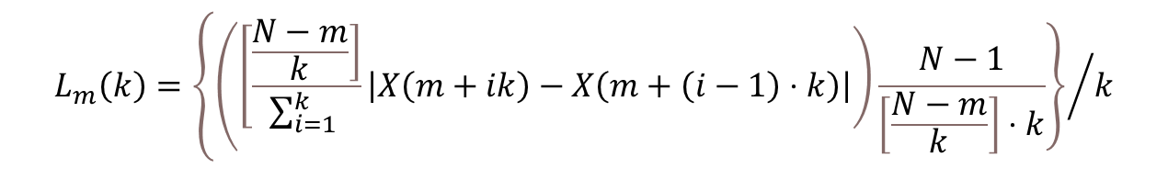
Materials and Methods (Cont…)
Higuchi’s Fractal Dimension
$$L_{m}\left(k\right)=\left\{{\left(\left[\frac{\left.\frac{N−m}{k}\right]}{\sum_{i=1}^{k}{ }}\left|X\left(m+ik\right)−X\left(m+\left(i−1\right)⋅k\right)\right|\right)\frac{N−1}{\left[\frac{N−m}{k}\right]⋅k}\right\}}/k\right.$$
log($L_{m}\left(k\right)$)
log(1. / k)
Slop of this line is the Higuchi’s Fractal Dimension
16

Slide 17
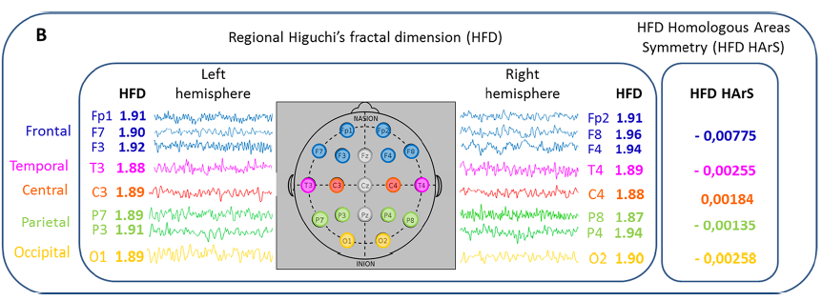

Materials and Methods (Cont…)
A signal is fractal if the scaling properties fit a scale-free behavior, i.e. the same features emerge at smaller and larger time scales
17

Slide 18
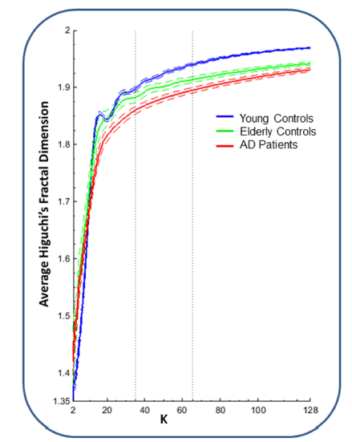
Experimental Results
Whole-brain average HFD in dependence on only one parameter of HFD algorithm is k_{max}.
Dashed curves represent the standard error of the mean.
Dotted lines at k_{max} = 35 and k_{max} = 65 represent starting point of HFD stability w.r.t the difference between groups, and the selected k_{max}.
18

Slide 19
Experimental Results
The standard error tells you how accurate the mean of any given sample from that population is likely to be compared to the true population mean. When the standard error increases, i.e. the means are more spread out, it becomes more likely that any given mean is an inaccurate representation of the true population mean
19

Slide 20
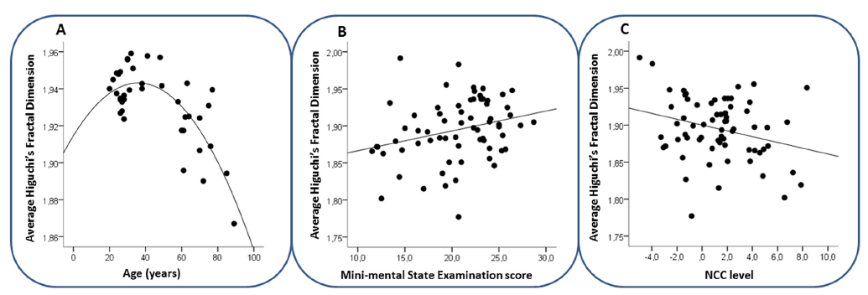
Experimental Results (Cont…)
Healthy subjects in relationship with age (years), with the best fitting curve.
AD patients with Mini-Mental State Examination score (MMSE) scores. We considered that MMSE values do not distribute as a Gaussian.
AD patients with Non-Ceruloplasmin-Bound Copper Levels (NCC) levels, with best fitting line.’
6/21/2021
20

Slide 21
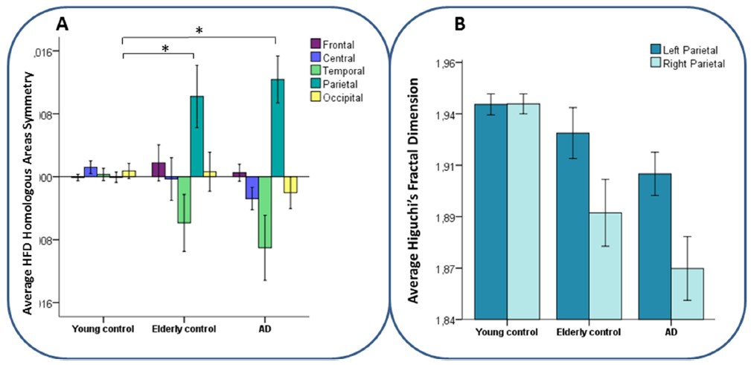
Experimental Results (Cont…)
Average HFD Homologous Areas Interhemispheric Symmetry (HArS) values of brain regions per group.
Parietal asymmetry in elderly controls and AD patients is caused by a stronger HFD decline in the right compared to the left hemisphere.
6/21/2021
21

Slide 22
Discussion
Fractal dimension depends on age in healthy people and is reduced in AD.
Fractal dimension depended most strongly on age.
EEG-derived fractal dimension is reduced with increasing levels of NCC in AD patients.

Slide 23
Conclusion
EEG-derived HFD measure is sensitive to neural changes selectively related to healthy aging and to Alzheimer’s Disease.
HFD is sensitive to the maturation of brain function over the life span and to disease progression in AD.
HFD to some extent captures region-specific neural changes in healthy aging and in AD.
23

Slide 24
Important References
Jeong J. EEG dynamics in patients with Alzheimer’s disease. Clinical Neurophysiology. 2004. p. 1490 505.
Niedermeyer E, Silva FHL Da. Electroencephalography: Basic Principles, Clinical Applications, and Related Fields [Internet]. Lippincott Williams and Wilkins. 2004. 1309 p. Available from: http://books. google.com/books?id=tndqYGPHQdEC&pgis=1
Babiloni C, Binetti G, Cassetta E, Forno GD, Percio C De, Ferreri F, et al. Sources of cortical rhythms change as a function of cognitive impairment in pathological aging: A multicenter study. Clin Neurophysiol. 2006; 117:252–68. PMID: 16377238
Ramon C, Holmes MD. Spatiotemporal phase clusters and phase synchronization patterns derived from high density EEG and ECoG recordings. Curr Opin Neurobiol [Internet]. 2014; 31C:127–32. Available from: http://www.ncbi.nlm.nih.gov/pubmed/25460068
24

Slide 25
Thank you

